Slide 1
The Impact of Family
Past and Present
Session 4 – Preparing for Marriage
http://markrobnett.com/MarriagePreparation

Slide 2
Which relationship is permanent?
Parent-Child: “That is why a man leaves his father and mother and is united to his wife, and they become one flesh.” Genesis 2:24
Husband-Wife: “Therefore a man shall leave his father and his mother and hold fast to his wife, and the two shall become one flesh’ So they are no longer two but one flesh. What therefore God has joined together, let not man separate.” Matthew 19:5,6
The Husband-Wife relationship must be primary!
Notes:
When the meddling of a parent violates the “leaving” because it is treating the parent-child relationship as primary (demanding obedience, dependence, or emotional oneness), it should be respectfully rejected.

Slide 3
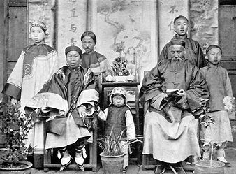
Traditional Chinese Family – 150 years ago
传统的中国家庭——150年前
(Paste a Picture Here)
Who has the most power in this family? 这个家庭谁最有权力？
Where are the strongest relationships? 最牢固的关系在哪里？
How were the roles of men and women different?
男人和女人的角色有怎样的不同？

Slide 4

Modern Chinese Family 现代中国家庭
Who has the most power in this family? 这个家庭谁最有权力？
Where are the strongest relationships? 最牢固的关系在哪里？
How are the roles of men and women different?
男人和女人的角色有怎样的不同？

Slide 5
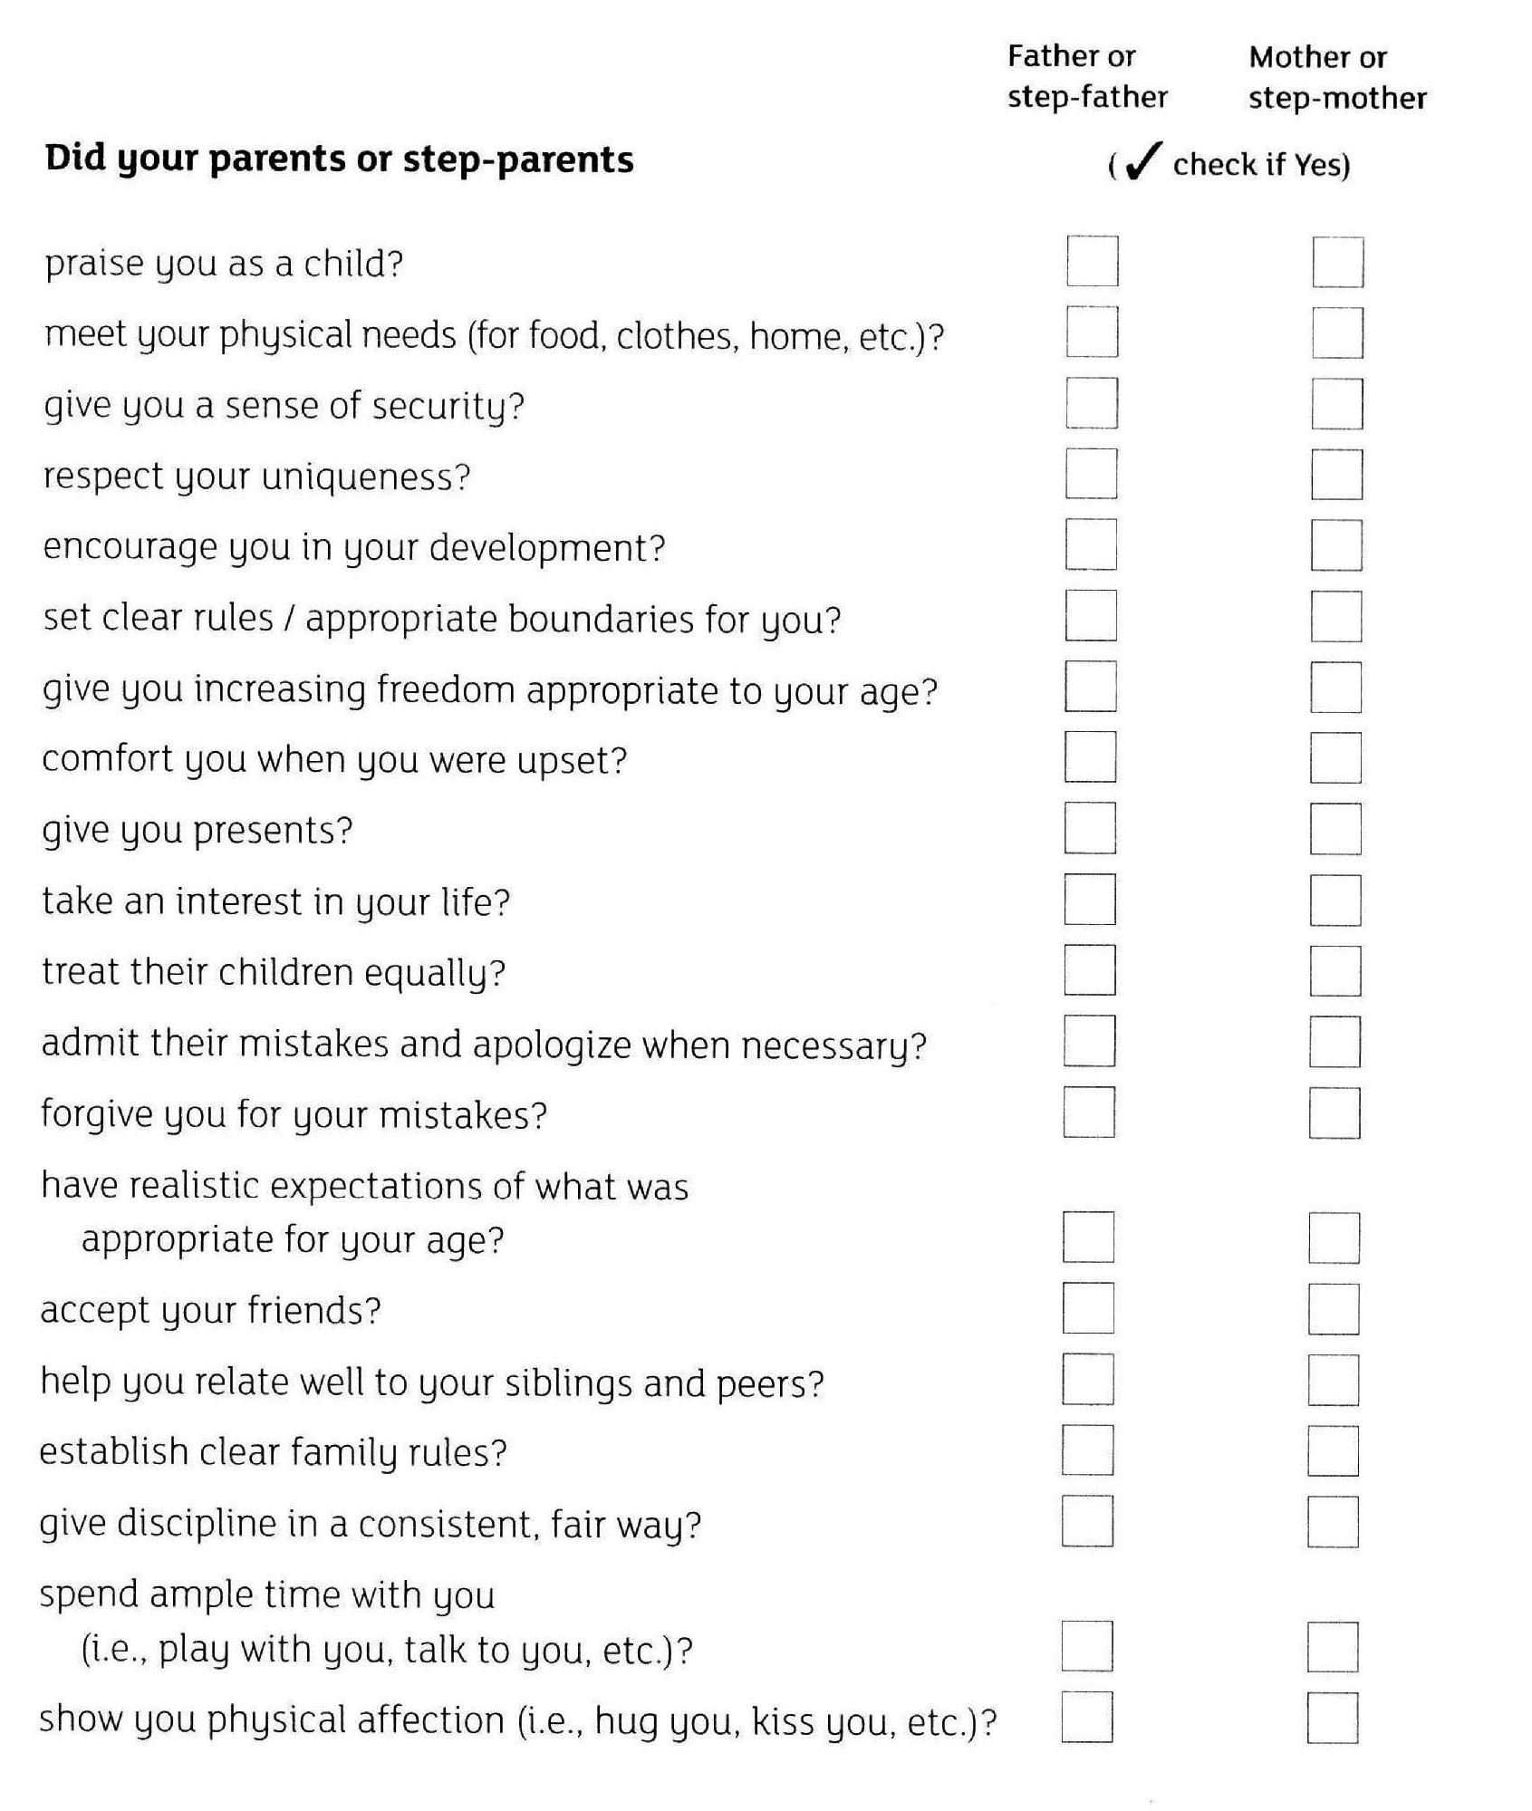
As a child:
Your relationship with your parents (or whoever brought you up)
Take 5 minutes to answer the questions, then share with your partner and discuss

Slide 6
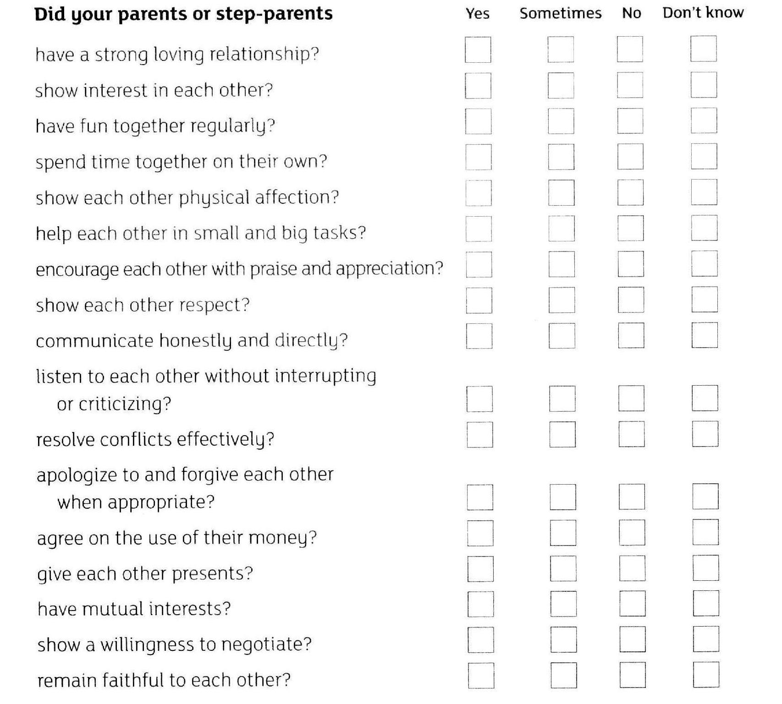
As a Child: the example of your parents
Take 5 minutes to answer the questions, then share with your spouse and discuss

Slide 7
Discuss these questions:
What do you need to be thankful about your upbringing?
Did you have any unmet childhood needs?
How can those unmet needs affect your marriage?
How can your marriage benefit from imitating your parents / step-parents / main caregivers?
How will your marriage suffer from imitating your parents / step-parents / main caregivers?

Slide 8
Expectations of New Family
这周—未来家庭的期望
Expectations are set by experience and are very powerful! 期望是由经验决定的并且是非常强大的
  Decision Making 决策
  Roles and Responsibilities 角色和责任
  Money and Possessions 金钱和财产

Slide 9
Decision Making 决策

Slide 10
Roles and Responsibilities 角色和职责

Slide 11
Money and Possessions 金钱和财产

Slide 12
Money and Possessions 金钱和财产
下面每一对陈述中，选择并在其中一条最符合你的家庭成长背景的陈述后打勾。完成后，计算每列中选择的陈述数量
尽量省钱 | 想买就买
担心钱用完了 | 不担心钱的问题
钱只花在必需品上 | 花钱买奢侈品
有时间放松 | 成年人总是在工作
东西坏了就修 | 东西坏了就扔
尽量存钱 | 花钱随意
父母教过如何省钱 | 没学过如何省钱
家庭花销向你解释过 | 家庭花销是迷
总是缺钱 | 从不缺钱
尽量少购物 | 喜欢购物——购物是一种休闲
对钱感到恐惧或迷惑 | 花钱不多想
父母教过如何计划用钱 | 父母管钱

Slide 13
Previous Family and New Family
现在和将来的家庭
What would you like to change?
为什么你想要改变？
What would you like to keep?
什么是你想保留的？
How will you make these changes?
你将如何做出这些改变？
What challenges will you face?
你将面对怎样的挑战？

Slide 14
Some Final Family Thoughts
最后的家庭观念
Your family background has a big influence on your new relationship: 你的家庭背景对你未来的关系有很大的影响
  Positive: Be thankful for the good things in your former family.积极的：感谢那些在你现在家庭中美好的事情
  Negative: No family is perfect. Be honest about the problems and difficult relationships. Decide that you will not repeat them in your new family. 消极的：没有家庭是完美的。坦率对待问题和困难的关系。下决心不让这些问题在你未来的家庭中重演。
  Different: Your family history is not the same as your spouse. Talk about the differences and choose expectations together for your new family. 不同的：你和你配偶的家族史并不一样。讨论这些差异并且为你们的新家庭选择共同的期望。

