Slide 1
The Art of Communications
Session 2 – Preparing for Marriage
http://markrobnett.com/MarriagePreparation
Notes:
Like receiving a vaccine, honest communications might hurt initially, but in the long-term, we can avoid the development of barriers and bitterness that might destroy unity.
You might have struggled with honesty – speaking or receiving it. You may still feel the pain (in the arm) of things you have said or heard in the past. Let me encourage you to continue speaking truth and listening with love to improve your relationship.

Slide 2
Your Marriage is Very Important !
Close Relationship (alone): “Then the LORD God said, ‘It is not good that the man should be alone; I will make him a helper fit for him.’” “Therefore a man shall leave his father and his mother and hold fast to his wife, and they shall become one flesh.” (Genesis 2:18,24)
An Important Picture: “Husbands, love your wives, as Christ loved the church and gave himself up for her, that he might sanctify her, having cleansed her by the washing of water with the word,” (Ephesians 5:25,26)
Glorify God: “So, whether you eat or drink, or whatever you do, do all to the glory of God.” (1 Corinthians 10:31)
Notes:
A Christian marriage is designed by God to be a visible image (in this world) of His relationship to the church – His saved people. Christianity is different than every other religion in the world, and our marriages can illustrate that. Consider this example:
After spending time with Susan, I knew that she was the one that I wanted to marry. So one day, I chose a special place and time to give her a very special gift – a cookbook. I then told her to look on page 282 and read the recipe for apple pie (one of my favorites). And I told her that if she could follow this recipe perfectly (and all of the others in the book), after 30 years I may choose to keep her as my wife.
Of course, I didn’t do this. If I did, she would have thrown the book at me and told me to get lost! But this is the way every other religion on earth operates. People join a group and start on a path of good works, trying to please their god enough, hoping that as they get to the end of the path, their merit will allow them to enter a permanent relationship with their god.
But Christianity is different. At the beginning of our Christian journey, Jesus has already done all of the work for us. He comes to us with His “engagement ring” (the Holy Spirit) and makes us His very own bride, completely apart from any merit on our behalf. We have a beautiful assurance of His unfailing love from the very beginning of our relationship. And as we rest in His secure embrace, we live a life of joyful good works out of thanksgiving for His amazing grace.
(this example was borrowed from John Lennox)

Slide 3
A Reminder:
Like anything important, good marriages don’t happen by chance – they take time and effort.
In the final three months of 2020, more than 1 million couples in China requested a divorce (13% increase over 2019).*
BEIJING 27-Mar-21: For Qi Jia, an office worker and blogger in China, the decision to divorce her husband was not one she took lightly. "He became so sloppy and had an addiction to gaming," Qi, 39, who lives in the eastern city of Changzhou, said. "I took care of our child by myself.“ The couple lived apart due to work, for 13 years and had little communication, she wrote in a personal testimony posted on the Chinese social media site, Douban.
* Data from Civil Affairs Bureau of China
Notes:
Many people assume that marriages will just get better over time, that disagreements will magically resolve, and that our relationship will get closer as we get older.
But I have some important news for you: as you get older, you get more demanding about your particular desires. Small things become big things, and big things become huge. If you want to have a strong marriage, it will take more effort than you think.
The only way to communicate “below the surface” is to take time together to dig deeper into thoughts, feelings, and meanings!

Slide 4
“Becoming One” is our goal, and can only happen with effective communication.
We all have a longing to be truly known by our spouse
Communication involves the speaker, the listener, and the message
We need to hear each other’s experiences, thoughts, feelings, and desires
You may have been taught to hide your feelings during upbringing, and it will take courage to re-learn how to talk about feelings
“speaking the truth in love,” Ephesians 4:15
Skill development requires education, discovery, practice, feedback, and improvement.
Notes:
Communication is an art – something that must be learned and practiced. You have already learned some things (especially from your family) – today, let’s examine how to improve this most important part of marriage.

Slide 5


Did you really understand me?
你真的理解我吗？
Thought
想法
2. Words
说话
Listening
听
3. Noise
噪音
5. Thought
想法
Speaking
说话
4. Hearing
听
Notes:
Good communications requires a many things to work out well:
It begins with a thought. I need to be thinking clearly about what I want to say.
I need to carefully choose the right words to capture the thought. Have you ever misspoken and the wondered “Why did I say that?”
All of the words that I speak need to reach your ears. But we live in a noise world, full of distractions.
You need to listen carefully to what I say to hear it all. And not just the words that I speak, but the way that I say them and the body language that goes along with them (which often says more than the words).
After hearing the words, you need to interpret them in the same way that I do. If you think differently about the meaning of my words, you will end up with a different thought.
So, what do you think? How likely is it that my original thought and your thought will be the same? Very unlikely! But you can learn some new skills, skills that will help you to be a better communicator!
Let’s start by talking about talking!

Slide 6
Speaking is affected by:
说话受到以下因素的影响
Our Personality 我们的人格
  Extrovert or Introvert 外向或内向
  Logical or Intuitive; man or woman 逻辑或直觉；男人或女人
Our Situation and Our Feelings 我们的处境和感受
  Too busy to focus on each other 太忙了以至于无暇顾及对方
  Emotions: Anger, Fears, Depression, etc 情绪：愤怒，恐惧，安全, 等等
Our Family Background 我们的家庭背景
  Was your family loud or quiet? 你的家人是安静的还是吵闹的？
  Did they talk about problems or ignore them? 他们谈论差异还是忽视差异？
Notes:
You might think that you are skilled at talking – after all, you’ve been doing it all of your life.
But think for a minute with me: do you always say the right thing at the right time? No one is perfect at speaking! There
If we learn a little more about things that limit our speech, we can improve this vital part of communications.

Slide 7
Notes:
Take a moment to think about how your family communicated. Which of these best describes your family? How do you think this affects the way that you communicated?
Separately, each person do this. When finished, compare results and answer the question at the bottom (How has the way that your family communicated when you were growing up affected the way you communicate now as an adult?)

Slide 8
Some Problems with Speaking
说话方面的一些问题
Relationships: We don’t say what we think, we say what we think the other person wants to hear. 关系：我们不会说我们想说的，我们会说被人相想听的。
Fear: We are afraid that we will sound stupid or be misunderstood, so we remain quiet. Perhaps we fear being hurt or betrayed. 恐惧：我们害怕我们说的话听起来很愚蠢或者被误解，所以我们保持沉默。也许，我们害怕被伤害或背叛。

Slide 9
Some Problems with Speaking
说话方面的一些问题
Too much: We talk all of the time and fail to listen to others. 说的太多：我们总是在说话并且听不进别人的话。
Surface Level: We only talk about practical things but never share what is really in our heart. 浮于表面：我们只谈论实际的事情，从不分享内心的真实想法。

Slide 10
Which is your biggest speaking problem?
Relationships: We don’t say what we think; we say what the other person wants to hear.
Fear: We are afraid that we will sound stupid or be misunderstood, so we remain quiet. Perhaps we fear being hurt or betrayed.
Too much: We talk all of the time and fail to listen to others.
Surface Level: We only talk about practical things but never share what is really in our heart
Is it difficult (or easy) to talk about your inner thoughts, attitudes, and emotions?
Notes:
Take a moment to think about each of these speaking problems.
Tell your partner which one you believe is your biggest problem, then listen to them share their problem. Also, discuss how difficult (or easy) it is to talk about your inner thoughts, attitudes, and emotions. Were you encouraged to share these things during your upbringing?
Seek to understand each other’s problem and plan to help each other be better speakers in your relationship.

Slide 11
Some Thoughts about Listening
Listening is one of the most important skills to learn for a strong marriage.
Careful listening has the power to make your spouse feel loved and valued.
Good questions lead to deeper conversations.
“My dear brothers and sisters, take note of this: Everyone should be quick to listen, slow to speak and slow to become angry,” James 1:19
“To answer before listening – that is folly and shame.” Proverbs 18:13

Slide 12
“Focused Listening” is Affected by:
“专注倾听”受以下因素影响：
Distractions 分心
  Busyness – not making time for each other
  忙碌—没有为对方腾出时间
  Mobile phones and messaging 手机和消息
  Thinking about what we will say next
Mental Filters 过滤
  Our attitudes, prejudices, and memories
  我们的态度、偏见和记忆
  We stop listening and start daydreaming
  缺乏兴趣—停止倾听并开始做白日梦
Notes:
Remember, men and women think and process differently.
Men tend to focus on one thing at a time (“dumpling” 饺子 Jiǎozi) and must mentally disengage with that thing in order to give full attention to their partner.
Women typically think of multiple items at the same time (“noodles” 面条 Miàntiáo), allowing them to move seamlessly from one topic to the next.

Slide 13
“Focused Listening” is Affected by:
“专注倾听”受以下因素影响：
  Interrupting – assume that we know what will be said
  打断—假设我们知道将会说什么
  Giving advice – solving “the problem”
  给出建议—解决问题
  Changing the subject – taking over the conversation
  转移话题—接管对话

Slide 14
Which of these your listening problem?
Distractions 分心: Busyness (忙碌); Mobile phones and messaging (手机和消息)
Mental Filters 过滤: attitudes, prejudices, and memories (的态度、偏见和记忆); Lack of interest (缺乏兴趣)
Interrupting (打断)
Giving advice (给出建议)
Changing the subject (转移话题)
Think about this for a minute, share with your partner, and see if they agree.
Notes:
You may struggle with one of these, or something else.

Slide 15
How to be a better listener?
如何成为一个更好的倾听者？
Pay attention and do not interrupt. Allow your partner to finish everything they want to say, maintain eye contact, and do not do something else at the same time. 注意并且不要打断。让你的伙伴说完他们想说的一切，保持眼神交流，而且不要同时做其他事情
Try to put yourself in your spouse’s shoes. Put your own views to one side and really appreciate what it is like to feel like your partner. Allow silences – do not rush. 试着换位思考。把你自己的观点放在一边，真正体会伙伴的感受。允许沉默—不要匆忙。

Slide 16
How to be a better listener?
如何成为一个更好的倾听者？
Acknowledge their feelings. When your partner is finished talking, reflect back the facts and the feelings you heard and saw. Ask if you understood them correctly. 了解别人的感受。当你的伙伴结束谈话时，尽可能清晰的反映事实和感受。问问你是否理解正确
Find out what is most important. Ask your partner “What is the most important part of what you have been saying?” Give them time to think and speak. 找出什么是最重要的。问问你的伙伴“你说的话中，最重要的部分是什么？”给他们时间思考和说，然后再反思。
Notes:
Being a good listener goes beyond spoken, literal words.
“This means not just listening with your ears, but also more importantly, listening with your eyes and your heart, listening for feeling, for meaning.” Steven Covey
Western cultures tend to be “High Content” (literal words)
Eastern cultures tend to be “High Context” (what goes unsaid) – the “third language.”

Slide 17
How to be a better listener?
如何成为一个更好的倾听者？
Help them work out what they might do. Now ask: “Is there anything you would like me to do about what you have said?” Give them time to think, speak, and listen to their own response. 帮助他们找出他们可能做什么。现在问：“对于你说的话，你有什么需要我做的吗？”给他们时间思考、说并且倾听他们自己的回答。
Also ask: “Is there anything more that you would like to say?” 还要问：“你还有什么想要说的吗？”
{How would you feel if your partner listened to you this way? 如果你的丈夫/妻子这样倾听你的话，你感觉如何？}
Notes:
In addition, discuss when you think is the best (and worst) time to talk about important things. (morning, evening, while walking, during meals, etc.).

Slide 18
Preparing for Marriage – Course Plan
Session 1 – Building Strong Foundations
Session 2 – The Art of Communications
Session 3 – Resolving Conflict
Session 4 – The Impact of Family
Session 5 – Shared Goals and Values
Session 6 – Keeping Love Alive

Slide 20
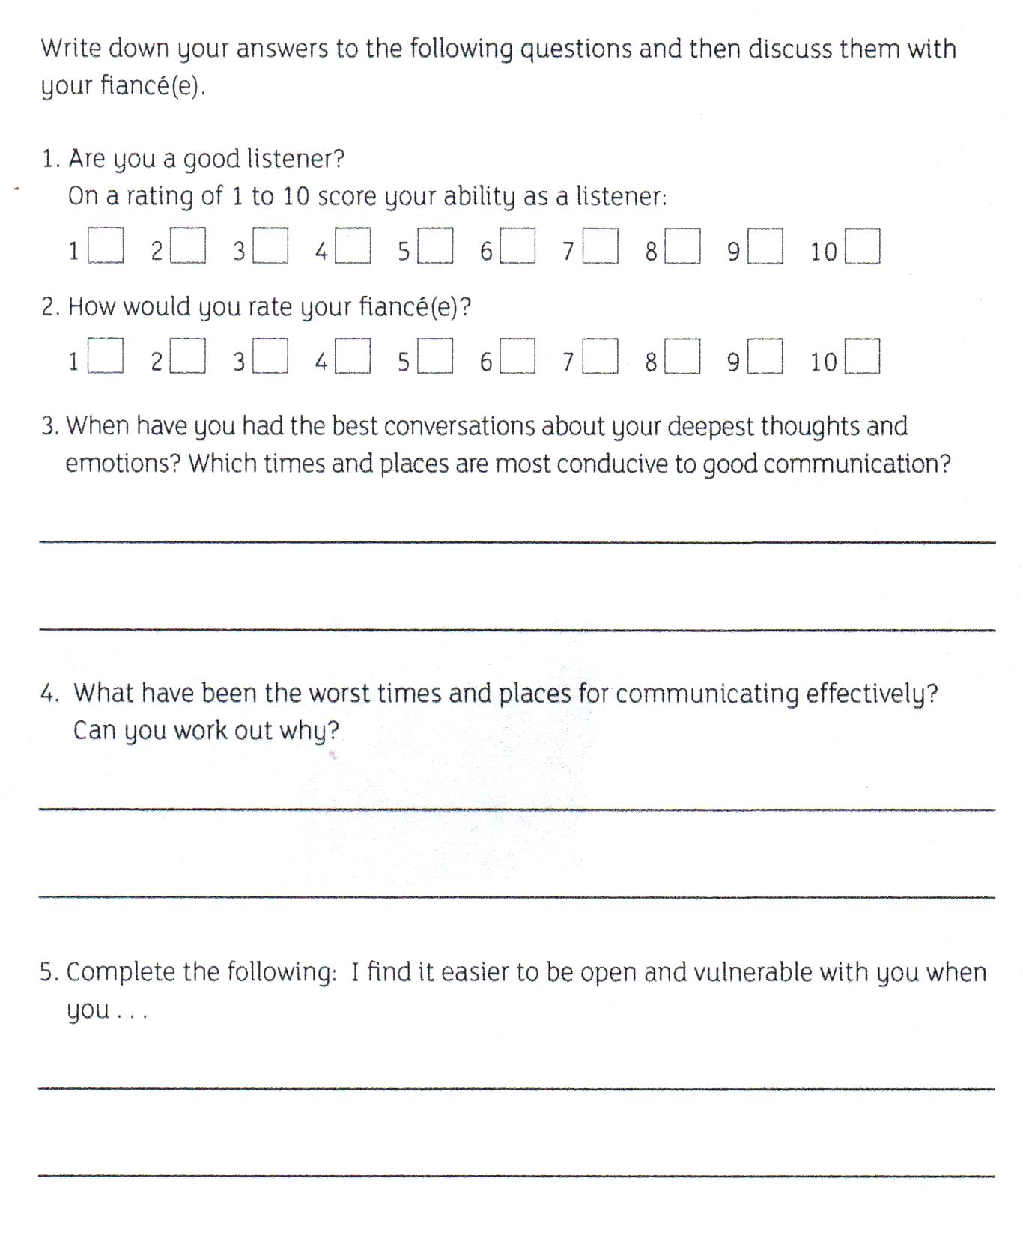
Homework #1: Communication Thoughts

Slide 21
Homework #2: Effective Listening Practice
Take turns speaking and listening with your partner.
Choose a topic that is currently important to you.
The speaker should hold a tissue to indicate whose issue is being discussed.
While the speaker is talking, the listener should focus on the words and emotions that are being shared.
The listener then asks: “What is the most important aspect of what you are saying?” The speaker responds and the listener reflects back again.
The listener then asks: “Is there anything you would like for me to do about what you have just said?”
The listener then asks: “Is there anything more that you would like to say?” The listener listens and reflects back again.
Notes:
Take time to do this! It might seem a little awkward at first, but with practice, it will become more natural.
Reflecting back what you have heard is a good way to show that you care about what the speaker has just said. Remember that people don’t always say what they are thinking and we don’t always hear what they are saying. Therefore, it can be helpful to reflect like this:
“What I think that I heard you say was this …”

Slide 22
Additional Information…

Slide 23
Are you an Extrovert or an Introvert?
你是内向还是外向？
仔细阅读下面问题，根据你的第一感觉回答是/否
1 | 你是个健谈的人吗？
2 | 你是个充满精力的人吗？
3 | 你愿意认识陌生人吗？
4 | 在热闹的聚会中你能使自己放得开，使自己玩得开心吗？
5 | 在结交新朋友时，你经常是积极主动的吗？
6 | 你能否很容易地给一个沉闷的聚会注入活力？
7 | 在社交场合你是否倾向于呆在不显眼的地方？
8 | 你是否喜欢和人们相处在一起？
9 | 你是否喜欢在自己周围有许多热闹和令人兴奋的事情？
10 | 你是否喜欢说笑话和谈论有趣的事？
11 | 在别人眼里你总是充满活力的吗？
12 | 你能使一个聚会顺利进行下去吗？
Notes:
仔细阅读下面问题，根据你的第一感觉回答是/否
Read the following questions carefully and answer yes/no according to your first feeling
Are you a talkative person?
Are you an energetic person?
Would you like to know strangers?
Can you relax yourself in a lively party and make yourself have fun?
Are you often proactive when making new friends?
Can you easily breathe life into a dull party?
Do you tend to stay inconspicuous places in social situations?
Do you like to be with people?
Do you like to have a lot of lively and exciting things around yourself?
Do you like to tell jokes and talk about interesting things?
Are you always full of energy in the eyes of others?
Can you make a party go smoothly?

Slide 24
Are you an Extrovert or an Introvert?
你是内向还是外向？
计分方法：除了第七题选择否记1分，选择是记0分，其他题目选择是记1分，选择否记0分。
For each “yes,” score 1, except question seven, score 1 for “no.”
外向：分数大于9分 Extrovert: greater than 9 points
内向：分数小于6分 Introvert: less than 6 points:
中间型：9-6分之间 Intermediate: 9-6 points

Slide 25
Body Language 肢体语言
55% of communication is visual (body language, eye contact)
55％的交流是视觉的（肢体语言，眼神交流）
38% is vocal (pitch, speed, volume, tone of voice)
38％是声音（语调，语速，音量，声调）
That means only 7% involves your actual words!
这意味着只有7％涉及你的实际话语！
This is why text messages are a bad way to communicate something important!
这就是为什么短信是一个传达一些重要信息的坏方法！

Slide 26
Everyone’s Body Language is Different : Watch for Changes 每个人都是不同的：留意变化
Many different ways to read body language – each individual person is different.
有很多不同的方式去观察肢体语言—每个人是不一样的。
Begin by looking for a normal “baseline.” When you see a major change, something might be wrong.
首先要寻找一个标准的“基线”。当你看到最主要的变化时，可能会出现一些问题
If you learn a little, you will know more than most people.
如果你学到了一点，你就会比大部分人了解的更多。

Slide 27
Changes to look for include:
需要注意的变化包括：
Face: look for upper and lower parts to agree
面部：寻找上下部分一致
Body movements: head nodding, hands and feet, relaxed or tight, crossed arms, etc.
肢体动作：点头，手和脚，放松或紧绷，交叉手臂等。
Vocal tone: fast, slow, loud, quiet, formal vs. informal, etc.
声调：快，慢，响亮，安静，正式与非正式等。
Physical actions: create distance, place something between you, etc.
身体动作：创造距离，在你们之间放置一些东西等。

