Slide 1
Session 1 : Building Strong Foundations
The Marriage Course
http://ilce.llc/MarriageClasses/Session 1- Foundations

Slide 2
Welcome to the Marriage Course!
Your are taking a step in the right direction for your marriage!
How much time and money do people usually spend to plan a wedding?
Does a couple just show up for a wedding and hope that everything will work out OK?
How much time and effort do people usually invest in planning their marriage?
Sadly, people often just show up for a marriage and hope that it will work out OK…
Notes:
We are not professional marriage counselors, but we do care about you!
Wedding clothing, photos, ceremony, dinner, guest lists, invitations, gifts, etc. Nothing is left to chance. But the wedding is quickly over.
The marriage is much more important and requires more work, but people fail to invest the time and energy preparing and working to make it successful. Perhaps that’s why so many marriages are quickly over…

Slide 3
Welcome to the Marriage Course!
Two goals of this course:
help you strengthen your connection with each other
give you “tools” to help grow your relationship
How will you do this?
Participate in the exercises and practice what you learn
Be honest with each other. Learn to trust each other.
We will not ask you to reveal anything personal to us.
Notes:
We are not professional marriage counselors, but we do care about you!
Strong relationships are built upon trust and trust is built upon honesty. Trust enables vulnerability, which fosters growth.

Slide 4
The First Time You Met
You were not forced to come together – you chose to be together voluntarily.
Think back to the start of your relationship…
Exercise 1. Tell each other your strongest memory of the first time you met and what first attracted you to one another. [ 3 minutes ]

Slide 5
What is Marriage?
It is not a business contract which is easily canceled when one person fails to meet their obligations.
It is not a friendship between two “children.”
It is much more than a legal partnership between two unchangeable adults.
It is a covenant between two people, sacrificially loving each other and becoming one.
Covenant: a formal, binding agreement of unconditional love
Notes:
Business contracts describe each party’s benefits and obligations. When one party fails to meet their obligations, the contract can be canceled.
Illustrate a business deal with two colored loops of paper, side by side, not connected.
Friendship of two children: two nested, colored loops still connected to mother and father. Wise parents teach their children to become independent and connect to their spouse.
Legal partnership: two colored strips connected end-to-end (still two sided). Splitting results in two separate loops, losing something from each other.
Covenant: two colored strips, twisted (turning away from my own desires) and connected with only one side (illustrated by drawing a line along the perimeter). Splitting results in a single loop.

Slide 6
What is Marriage?
During this class, we will often refer to the Bible to explain important marriage principles.
(The Bible is the most popular book in world history)
You do not have to be a Christian to learn from this class!
“That is why a man leaves his father and mother and is united to his wife, and they become one flesh.” 因此人要离开父母，和妻子连合，二人成为一体。
Genesis 2:24
Notes:
During this class, we will often refer to the Bible to explain important marriage principles. It is the most popular book in world history and is accepted as wisdom in every culture.
You do not have to be a Christian to learn from this class!
God created us – our amazing bodies show that He is an Amazing God with awesome wisdom!
In the very beginning of the Bible, after He creates people, God designs marriage. Marriage was not an invention of man! Therefore it is very important to understand and follow His plan!

Slide 7
Three pillars to a good marriage: 美好婚姻的三大支柱
“That is why a man leaves his father and mother and is united to his wife, and they become one flesh.” Genesis 2:24
Leave 离开
Unite 连合
Become one 成为一体
Notes:
There are three key points in God’s design for marriage and each one is important for your success.

Slide 8
“Leaving” – a Healthy Independence “离开” – 健康地独立于父母
Learn to stand as a new family unit in the world 学习成为世界上的一个单元
Learn to provide for yourselves 学会自食其力
Learn to set goals and make decisions together 学习定目标、做决定
Have a different relationship with parents while respecting and loving them 孝敬父母
Notes:
This is not a Western idea – it comes from the Bible which was written in the Middle East 4000 years ago.
Changed relationship areas:
Emotional – We are no longer emotionally dependent upon their parents.
Physical – Do not make a daughter-in-law live with her mother-in-law. Don’t expect to spend as much time with parents as before marriage.
Financial – Do everything possible to avoid indebtedness, even to parents. It is better to sacrifice financially than to sacrifice your marriage. Remember, “the borrower is the slave of the lender” Proverbs 22:7
Psychological – Some parents use guilt to control married children. Keep a healthy distance to avoid manipulation.

Slide 9
Uniting with each other 彼此“连合”
Strongly bound, remaining faithful to each other 紧密结合，忠贞不渝
Not doubting the person – assuming the best intentions 不怀疑对方，总往最好的方面想
Conscious decision to protect your relationship 有意识地决定捍卫关系
Treasure and value your relationship above all others 珍爱看重关系，胜过世上一切

Slide 10
Becoming One 合而为一
Your relationship is high priority: be passionate to protect it from anything that tries to come between you. 我们的关系是最重要的:我们要积极地保护它不受来自我们之间的任何东西的伤害。
A good husband / wife will also be a good parent, son / daughter, neighbor, and employee. 一个好的丈夫/妻子也会是一个好的父母、儿子/女儿、邻居和雇员。
Your goal: emotional, intellectual, physical, and spiritual unity. 我们的目标:情感、智力、身体和精神的统一。
Oneness
一致性
Intimacy亲密感
Vulnerability 脆弱
Trust信赖

Slide 11
Why do some Marriages break down?
A process of growing apart
A lack of communication
Self-centered consumer mentality
Lack of sacrificial love

Slide 12
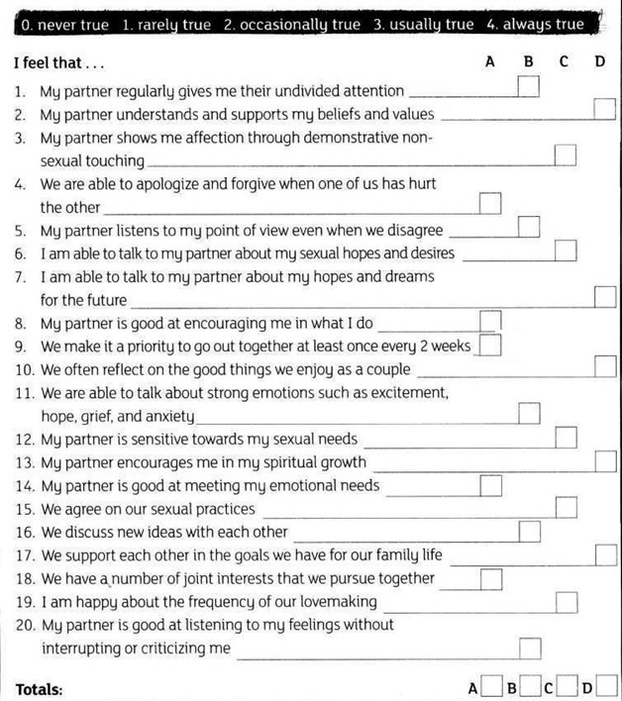
Think About Your Relationship, p.1
For each statement, write a number in the box which you feel is true about your relationship.
Do the exercise on your own!
When you are finished, total the score for each column (A,B,C,D)

Slide 13
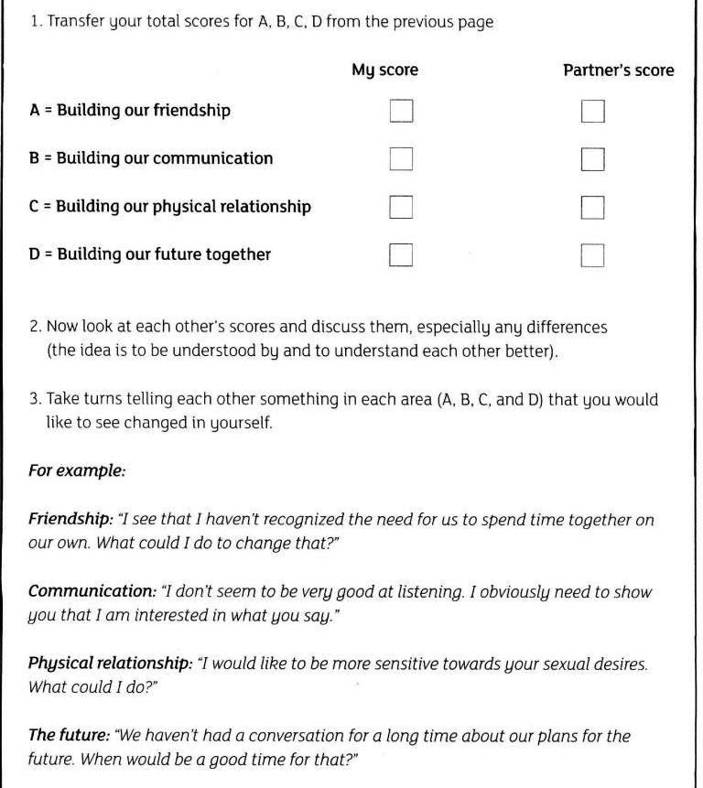
Think About Your Relationship, p.2
Transfer the scores from the previous page for A,B,C,D.
When you are both finished, write your partner’s score on the extra column.
Look at the numbers and discuss any large differences.
Take 25 minutes.

Slide 14
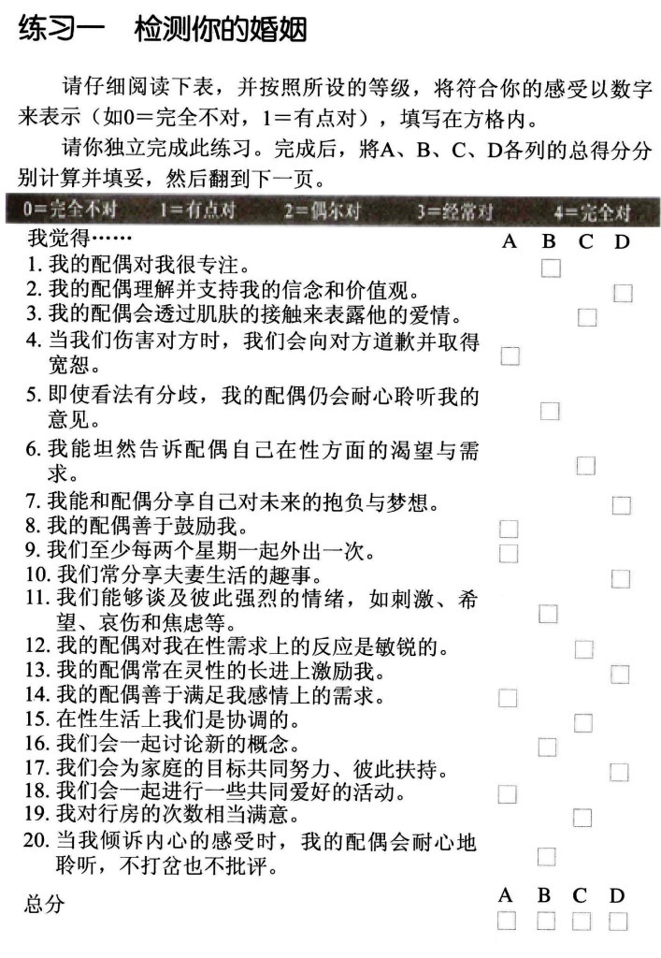
Think About Your Relationship, p.1
For each statement, write a number in the box which you feel is true about your relationship.
Do the exercise on your own!
When you are finished, total the score for each column (A,B,C,D)

Slide 15
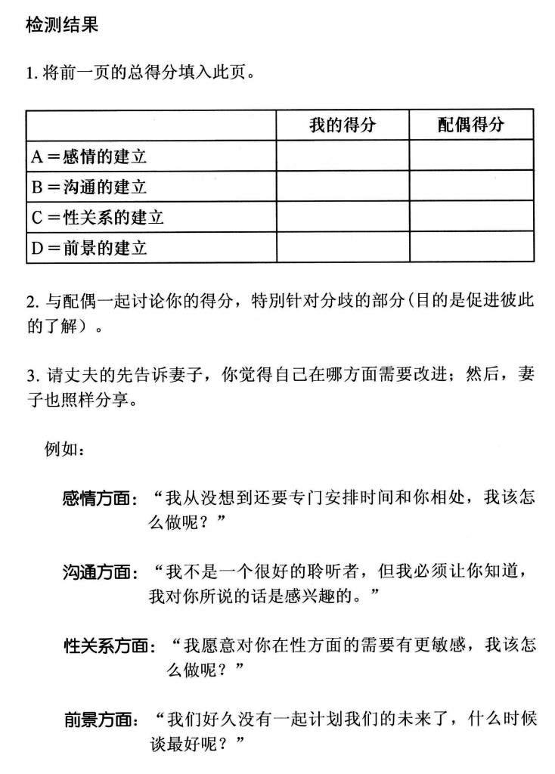
Think About Your Relationship, p.2
Transfer the scores from the previous page for A,B,C,D.
When you are both finished, write your partner’s score on the extra column.
Look at the numbers and discuss any large differences.
Take 25 minutes.

Slide 16
Foundations for a Strong Marriage: Nurturing Each Other
We are made for relationships: “The LORD God said, ‘It is not good for the man to be alone. I will make a helper suitable for him.’” 耶和华 神说："那人独居不好，我要为他造个和他相配的帮手。" Genesis 2:18
We all have a longing to be loved and known by another.
Becoming one requires that we learn to understand and meet each other’s needs (talk to each other!).
Focus on your partner’s needs, not their faults.

Slide 17
Foundations for a Strong Marriage: “Marriage Time”
We must make time for each other to talk about our feelings (hopes, fears, worries, excitements, etc).
Every week, plan to spend at least 2 hours alone (like a date night)!
You must plan, prioritize, and protect this time!
Plan: it won’t happen unless you schedule it
Prioritize: your marriage is very, very important
Protect: remove sources of interruption (work, phone, etc.)

Slide 18
The Marriage Course Plan
Session 1 – Building Strong Foundations
Session 2 – The Art of Communications
Session 3 – Resolving Conflict
Session 4 – The Impact of Family
Session 5 – The Power of Forgiveness
Session 6 – Keeping Love Alive

Slide 19
Homework (remember – your marriage is worth it!)
Exercise 5 (in English) Exercise 2 (in Chinese): Knowing Me, Knowing You
Exercise 1: Planning to Succeed
Exercise 2: Showing Love

